Slide 1



Genetic Programming
HAMSAVARDHINI B
7376221CS159

Slide 2


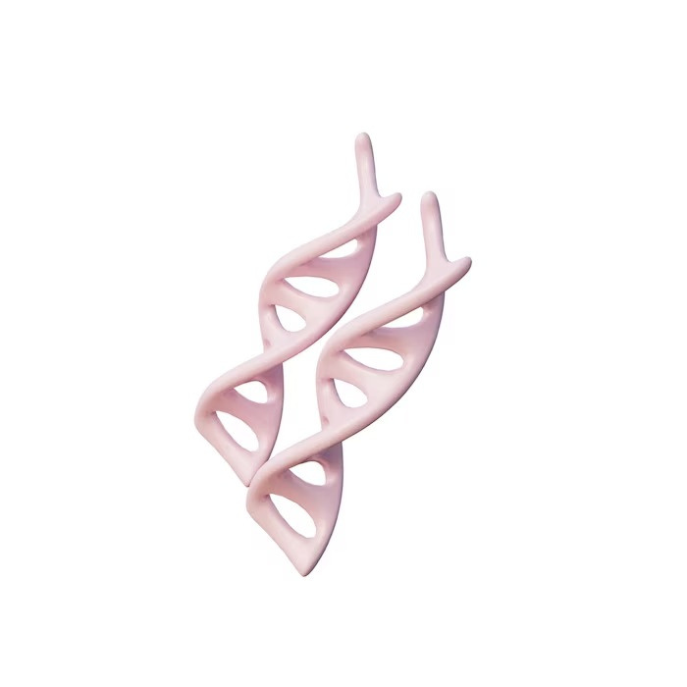
Unleashing the Potential of
Genetic Programming
Genetic Programming is a powerful machine learning technique that uses evolutionary algorithms to optimize complex models. This presentation provides a comprehensive overview of the field, including its history, applications, and future prospects.

Slide 3



Evolutionary Algorithms
Evolutionary algorithms are a family of optimization algorithms that mimic the process of natural selection to find the best solutions to complex problems. Genetic programming is a type of evolutionary algorithm that uses tree based representations to evolve computer programs.

Slide 4
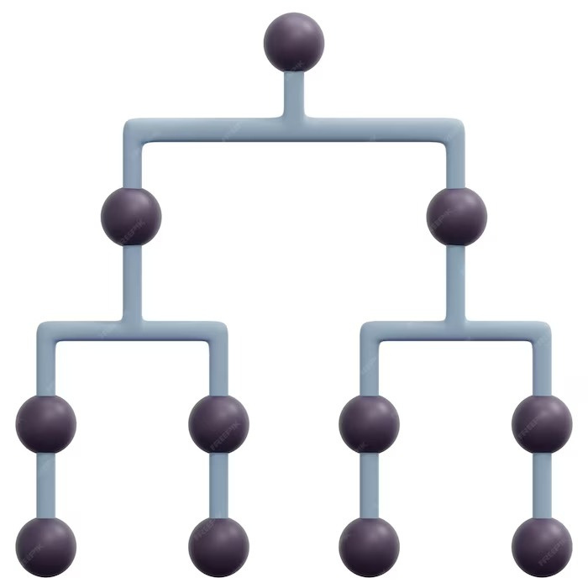
Tree-Based Representations
Tree-based representations are a powerful way to represent computer programs in genetic programming. They allow modularity, reusability, and scalability. Tree-based representations can be used to evolve programs that perform a wide range of tasks, from simple mathematical operations to complex control strategies.

Slide 5



Fitness Functions
Fitness functions are used to evaluate the quality of solutions in genetic programming. They measure how well a program performs a given task and are used to guide the evolution process. Fitness functions can be hand-crafted or learned from data.
Fitness functions are used to evaluate the quality of solutions in genetic programming. They measure how well a program performs a given task and are used to guide the evolution process. Fitness functions can be hand-crafted or learned from data.

Slide 6


Challenges and Future Prospects
Despite its success, genetic programming still faces many challenges, such as scalability, interpretability, and reliability. However, recent advances in the field, such as deep learning and neuro evolution, offer exciting prospects for the future of genetic programming.

Slide 7

Crossover and Mutation
Crossover and Mutation
Crossover and mutation are the two main operators used in genetic programming to create new solutions. Crossover involves combining parts of two parent solutions to create a new solution. Mutation involves randomly changing parts of a solution to create a new solution.
Crossover and mutation are the two main operators used in genetic programming to create new solutions. Crossover involves combining parts of two parent soltns to create a new solution. Mutation involves randomly changing parts of a solution to create a new solution.

Slide 8
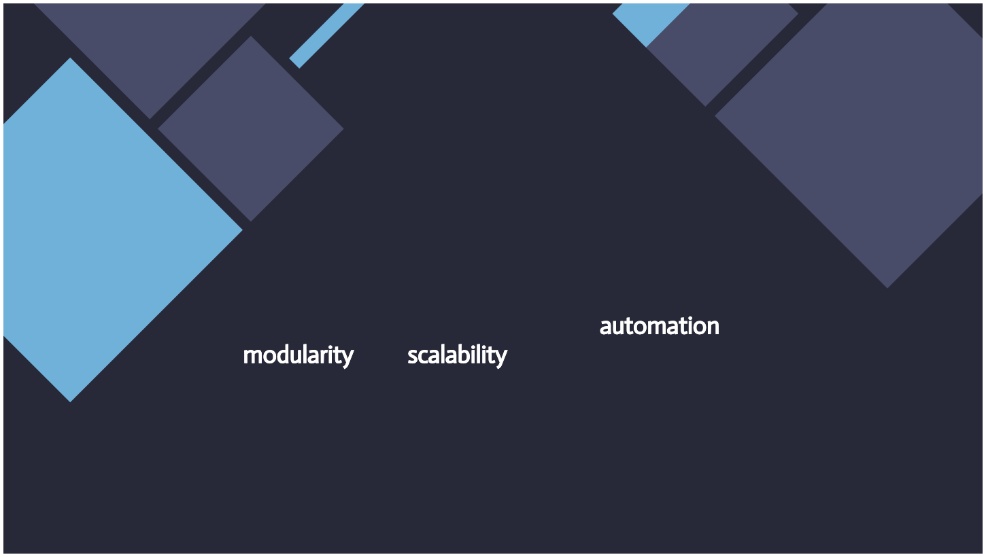
Conclusion
Conclusion
Genetic programming is a powerful machine learning technique that has been used in a wide range of applications. It offers many advantages over traditional programming, such as automation, modularity, and scalability. Despite its challenges, genetic programming has a bright future ahead.
Genetic programming is a powerful machine learning technique that has been used in a wide range of applications. It offers many advantages over traditional programming, such as automation, modularity, and scalability. Despite its hallenges, genetic programming has a bright future ahead.

Slide 9

Thank
THANK YOU !

